Slide 1
IMAGE RETRIEVAL BASED ON
FEATURES AND
CLUSTERING TECHNIQUES

Slide 2
OUTLINE:
1.Introduction
2.Overall Process of Image Mining
3.Image retrieval using feature based techniques
4.Image retrieval using clustering-based techniques
5.Conclusion

Slide 3
INTRODUCTION:
Images can hide valuable information. The need for image retrieval is high in view of the fast growing amounts of image data.
Text based retrieval – based on the keywords in the user’s query rather than content of the image.
The CBIR focuses on image features such as color, shape, region etc to
retrieve images.
1.Feature based techniques
2.Clustering techniques

Slide 4
OVERALL PROCESS OF IMAGE MINING:
Data Pre-processing :
Lot of dirty and noisy data exist in large image databases which cause chaos.
This phase removes them to highlight the features of that image.
Extracting multi-dimensional feature vector:
Using image processing technologies such as image Segmentation, picking up the edge
to extract task related feature vectors, form multi-dimensional feature vectors.
Mining on vectors and acquire high-level knowledge:
Methods like object recognition, image indexing and retrieval, image classification and clustering, are used on feature vectors for mining and acquiring hidden and valuable high- level knowledge, then evaluate and explain that exact query related knowledge.

Slide 5
FEATURE BASED CLUSTERING TECHNIQUES:
Color is considered as the most dominant and distinguishing visual feature
Color based retrieval:
Generally, it adopts histograms to describe it
More frequently used technique for image retrieval due to its efficiency and effectiveness.
Advantages:
Speed, low memory, doesn’t affect with image’s change of the size and rotation.
Texture based retrieval:
Textures are characterized by differences in brightness with high frequencies in the image spectrum
They are useful in distinguishing between areas of images with similar color (such as sky and sea, or water, grass)

Slide 6
Shape based retrieval:
Shape information are extracted using histogram of edge detection.
Techniques for shape feature extraction are elementary descriptor, Fourier descriptor, template matching, etc.
Less developed than their color and texture counterparts because of the inherent complexity of representing shapes
Rarely used

Slide 7
CLUSTERING BASED RETRIEVAL:
Log –Based Clustering:
Images can be clustered based on the retrieval system logs maintained by an information retrieval process
The session keys are created and accessed for retrieval
Through this the session cluster is generated.
Each session cluster generates log –based document
Log –based vector is created for each session vector based on the log-based documents
A hybrid matrix is generated with at least one individual document vector and one log-based clustered vector and it is clustered
This technique is difficult to perform in the case of multidimensional images

Slide 8
Association rule:
This method help us for Prediction We will discuss this with an example if sky contains black clouds so there are 64% chances it will rain.
The method is as follows:-
It segmented the images into blobs (region descriptor) where blob is equal to an object
Compare blob with all other blobs with an id. This works as a pre-processing algorithm
After that Create Auxiliary images with identified objects
Apply data mining techniques to produce object association rule
Basically this technique used for selecting images for a particular field (eg. Weather, medical images).
Usage:

Slide 9
Minimum spanning tree –based clustering:
proficient of detecting clusters with irregular boundaries.
The technique constructs ‘k’ clusters with segments.
This approach is very much capable of protecting detail in low variability image regions while not considering detail in high variability regions which is the maina dvantage of this approach.

Slide 10
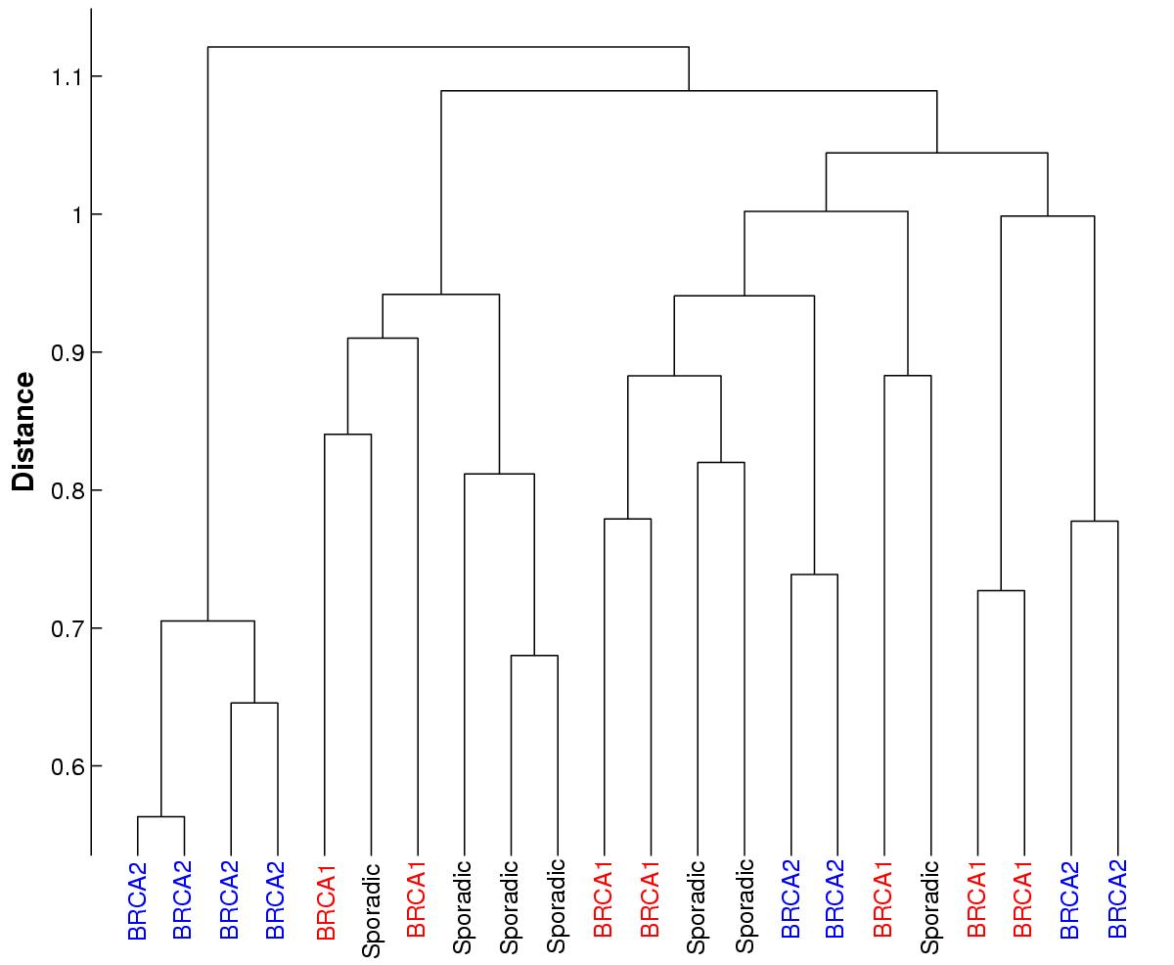
Hierarchical clustering:
Agglomerative (top down) clustering method.
As its name suggests, the idea of this method is to build a hierarchy of clusters, showing relations between the individual members and merging clusters of data based on similarity
In the first step of clustering, the algorithm will look for the two most similar data points and merge them to create a new "pseudo-datapoint", which represents the average of the two merged datapoints.
Hierarchical clustering results in a "tree", showing the relationship of all of the original points.

Slide 11
Graph theory- based clustering:
It can be used for detecting clusters of any size and shape without specifying the actual number of clusters.
Usually this clustering methodology is used to detect irregular clustering boundaries in clustering results.
Zhan [12] proposes to construct an MST and delete the inconsistent edges, i.e. the edges weight values are significantly larger than average weight of the nearby edges in the tree
The inconsistency measure[18] is applied to each edge to detect and remove the inconsistence edges,
which results as a set of disjoint subtrees, each subtree will represent a separate cluster.

Slide 12
Divide and Conquer K-Means- based clustering
When the size of a data set is too large, it is possible to divide the data into different subsets and to use the selected cluster algorithm separately to these subsets
It first divides the entire data set into a subset based on some criteria
The selected subset is again clustered with a clustering algorithm K-Means
The advantage is to accelerate search and to reduce complexity which depends on number of samples

Slide 13
HDK Algorithm:
It involves two steps.
Pre-processing is based on RGB color Components using Hierarchical clustering Method.
Apply divide and conquer k means
This includes three main steps.They are
1.Preprocessing is done by applying hierarchical clustering algorithm based on color feature.
2.After preprocessing find the no of clusters for sub space sampling
3.And in final step we separately cluster each sub spaced samples using k means clustering technique.

Slide 14
CONCLUSION:
This paper presents a survey on various image mining techniques that was proposed earlier. The purpose of this survey is to provide an overview of the functionality of image retrieval. Combining advantages of HC and divide and conquer K-Means strategy can help us in both efficiency and quality

